Slide 1
UNIVERSITY OF BUEA | FACULTY OF ENGINEERING AND TECHNOLOGY
Department of Computer Engineering • CEF 440: Internet & Mobile Programming • Task 7: Final Presentation
NetPulse
Design and Implementation of a Mobile App for Collection of
User Experience Data from Mobile Network Subscribers
Group 19 | Course Instructor: Dr Nkemeni Valery
PRESENTED BY
Djeugwa Weah Maximilienne FE23A036
Essoh Roddick Essoh FE23A048
Tchouanmou Touonang Whitney Elsa FE23A165
Bezia Precious FE23A026
Lorel Ekamba Ako-Tabe FE23A083

Slide 2
PRESENTATION ROADMAP
OVERVIEW
01
Introduction & Problem Statement
02
Requirement Gathering & Analysis
03
System Modelling & Design
04
UI/UX Design & Frontend
05
Database & Backend Implementation
06
Testing, Deployment & Results
07
Marketing Strategy & Business Model
08
Challenges & Conclusion
1

Slide 3
Introduction
2

Slide 4
INTRODUCTION
Background of the Study
Mobile growth: Smartphones and mobile apps now underpin learning, work, entertainment, and commerce — all dependent on network performance.
QoS vs QoE: Traditional QoS metrics (speed, latency, jitter) don't fully capture how users actually experience the network.
Existing tools fall short: Apps like Speedtest, nPerf, and OpenSignal show raw metrics but rarely translate them into meaningful experience insights.
Our solution: NetPulse — a cross-platform app that measures network performance AND evaluates real user Quality of Experience (QoE).
3

Slide 5
INTRODUCTION
Problem Statement
Inconsistent experience: Despite infrastructure improvements, users still face unreliable internet performance.
Raw data, no interpretation: Existing tools display numbers without explaining how they affect the user's real experience.
Limited history & intelligence: Few apps offer historical analysis, QoE evaluation, or improvement recommendations.
The gap: Users struggle to judge if their connection suits a task, or to spot patterns of degradation over time.
4

Slide 6
INTRODUCTION
Aim & Objectives
Design, develop, and evaluate a cross-platform mobile app that measures network performance and assesses Quality of Experience (QoE) for Cameroonian mobile subscribers.
1
Design an intuitive, user-friendly monitoring interface
2
Measure download/upload speed, latency, jitter & network type
3
Store test results locally and remotely
4
Analyze data to estimate user QoE
5
Visualize historical performance via reports & graphs
6
Provide insights & recommendations to users
7
Implement a secure backend for storage & sync
8
Test, evaluate, and deploy using industry practices
5

Slide 7
INTRODUCTION
Scope, Significance & Methodology
SCOPE
SIGNIFICANCE
Android-first, cross-platform capable app
Registration, network testing, history, visualization & QoE scoring
Excludes ISP infrastructure management & hardware optimization
Helps users judge if their network suits streaming, work, or study
Gives operators (MTN, Orange, Camtel) insight into real experience
Provides researchers a platform for QoE data collection
DEVELOPMENT METHODOLOGY
Requirement
Gathering
→
Analysis &
SRS
→
System
Modelling (UML)
→
UI/Backend
Development
→
Testing
→
Deployment
6

Slide 8
Requirement Gathering & Analysis
7

Slide 9
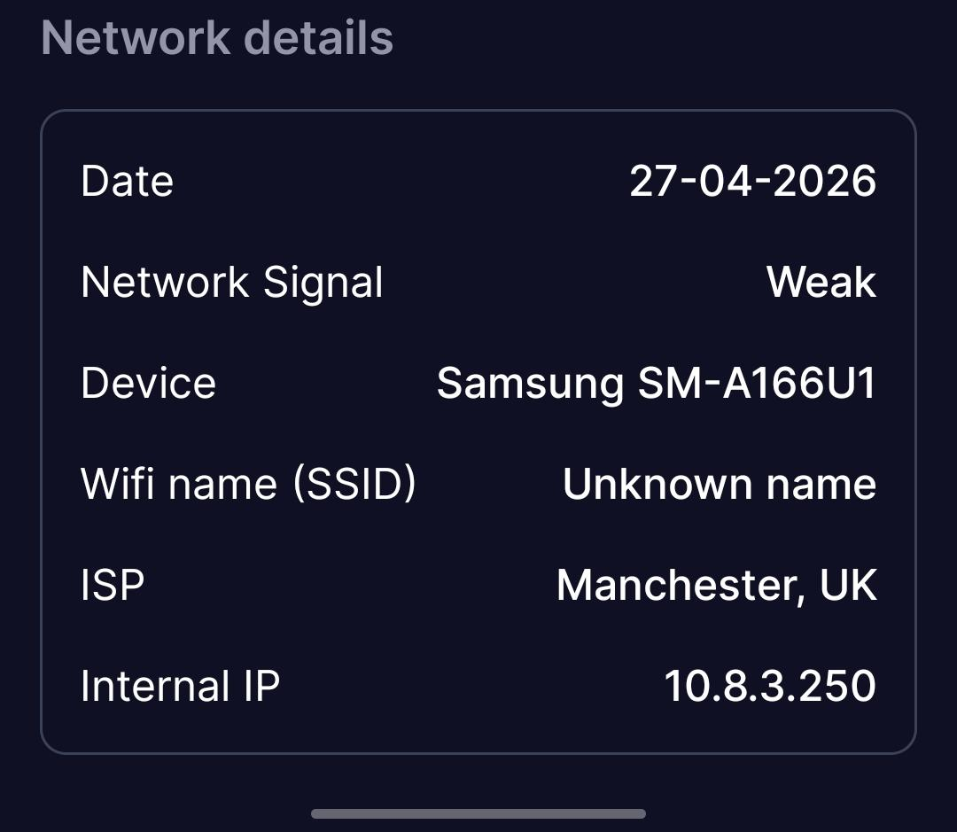
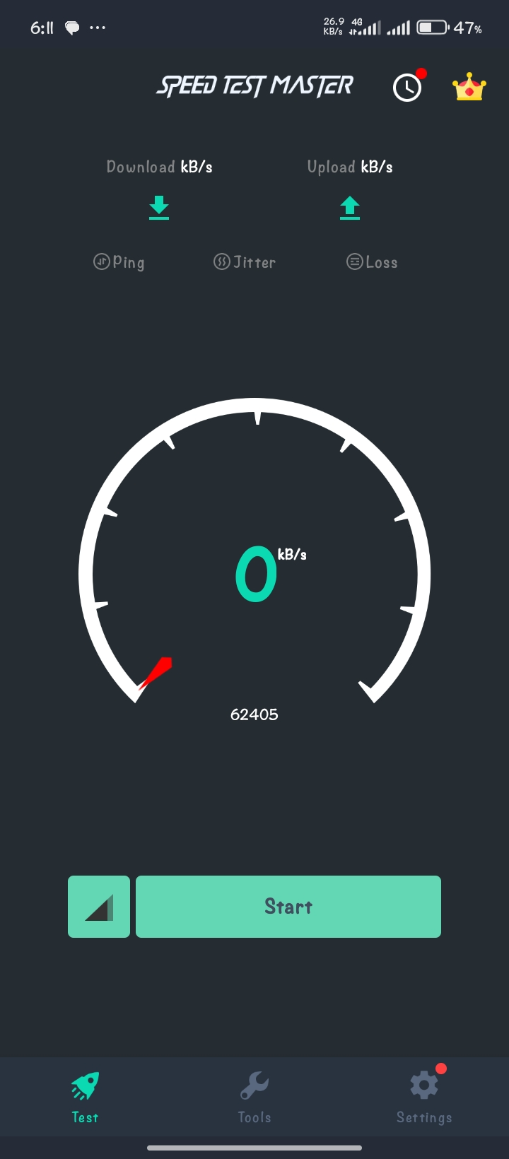
REQUIREMENT GATHERING
Stakeholders & Techniques Used
STAKEHOLDERS
TECHNIQUES USED
Primary: Mobile subscribers, MTN/Orange/Camtel, our dev team
Secondary: Regulatory bodies, researchers & data analysts
Surveys: Bilingual Google Form — 121 responses
Interviews: Informal sessions to capture expectations
Brainstorming: Background monitoring, alerts, ratings
Reverse engineering: Speedtest, OpenSignal, NetMonster
e.g. survey process photo / speed-test sample screenshot
8

Slide 10
REQUIREMENT GATHERING
Survey Findings (121 Responses)
57.9%
52.9%
71.9%
71.1%
rate network experience as Poor
hit poor quality many times daily
never used a network monitoring app
worry about data usage by a new app
40.5% use MTN, 20.7% Orange, and 36.4% use multiple networks
61.2% rely mainly on 4G/LTE mobile data
66.9% are concerned about privacy; 52.1% about battery drain
70.8% would be willing to install a background-monitoring app (with conditions)
9

Slide 11
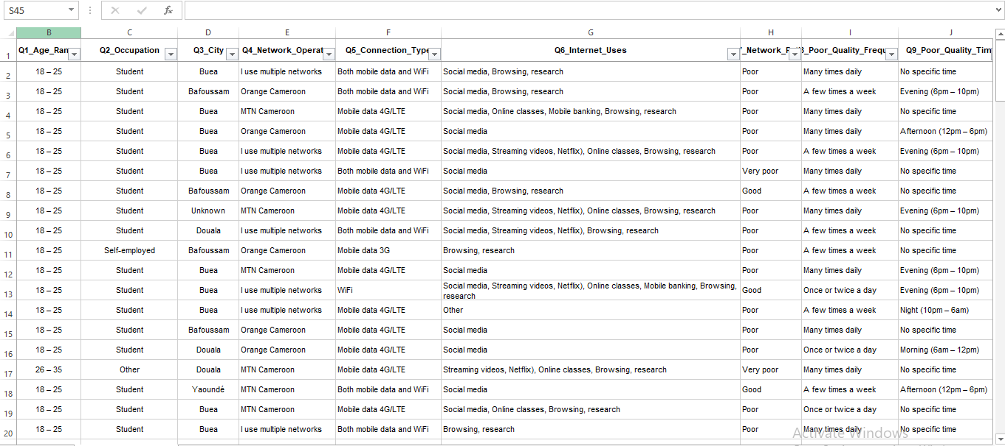
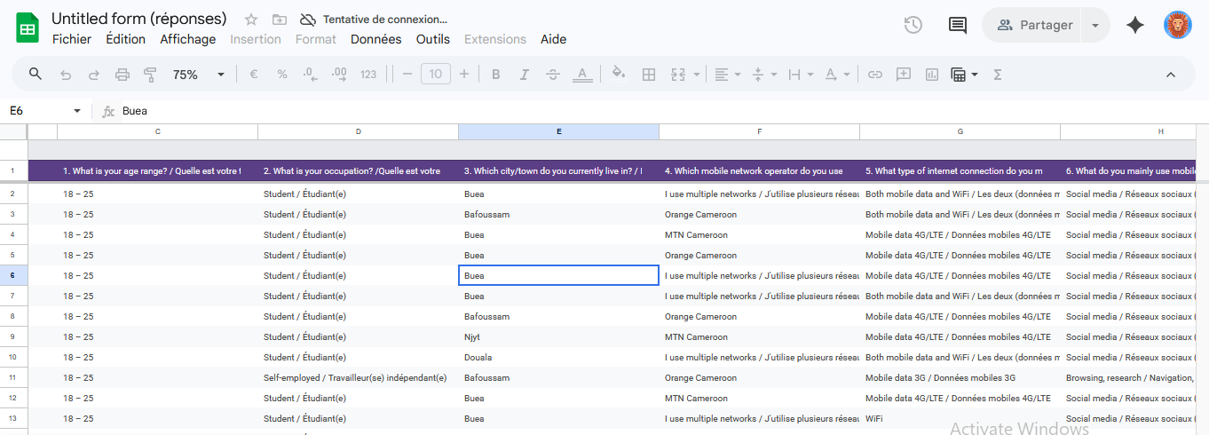
REQUIREMENT GATHERING
Data Cleaning & Observations
DATA CLEANING STEPS
KEY OBSERVATIONS
Removed duplicate survey responses
Corrected inconsistent entries (network-type formats)
Filtered out incomplete responses
Standardized dates & numeric values
Low satisfaction with speed, especially at peak hours
Frequent instability — dropped connections, slow browsing
Perceived vs. measured performance often disagree
Strong interest in a low-battery, automatic feedback app
10

Slide 12
REQUIREMENT GATHERING
User Reluctance Assessment
Reluctance Factor | Description
Battery drain fear | Background operation may deplete battery
Data usage concern | Fear of unexpected consumption on limited plans
Privacy invasion | Location/device tracking feels like surveillance
Annoyance from prompts | Frequent feedback requests interrupt use
Low trust in operators | Subscribers don't always trust MTN/Orange/Camtel
SOLUTIONS ADOPTED
Clear privacy policy + user control over data sharing
Battery-optimized background processing + transparency on data use
11

Slide 13
REQUIREMENT ANALYSIS
Prioritization & Classification
PRIORITIZATION
CLASSIFICATION
High
Background monitoring, auto metric collection, feedback, secure storage, GPS/timestamp
Functional: Auto metric collection, feedback submission, timestamp/GPS storage, sync, QoE reports
Non-Functional: Security, low battery use, reliability, usability, scalability
Medium
Visualization dashboard, offline sync, notifications/alerts
Low
Social sharing, multi-language, personalized themes
12

Slide 14
REQUIREMENT ANALYSIS
Software Requirements Specification (SRS)
FUNCTIONAL REQUIREMENTS
NON-FUNCTIONAL REQUIREMENTS
Secure user authentication
Continuous background monitoring
User feedback & satisfaction rating
Collect signal strength, speed, latency, jitter, GPS
Data synchronization with backend server
QoE report & analytics generation
Performance: Fast, efficient operation
Security: Encrypted, protected user data
Reliability: Crash-free continuous operation
Usability: Simple, intuitive interface
Scalability: Supports large user bases
Maintainability: Easy to update
13

Slide 15
System Modelling & Design
14

Slide 16
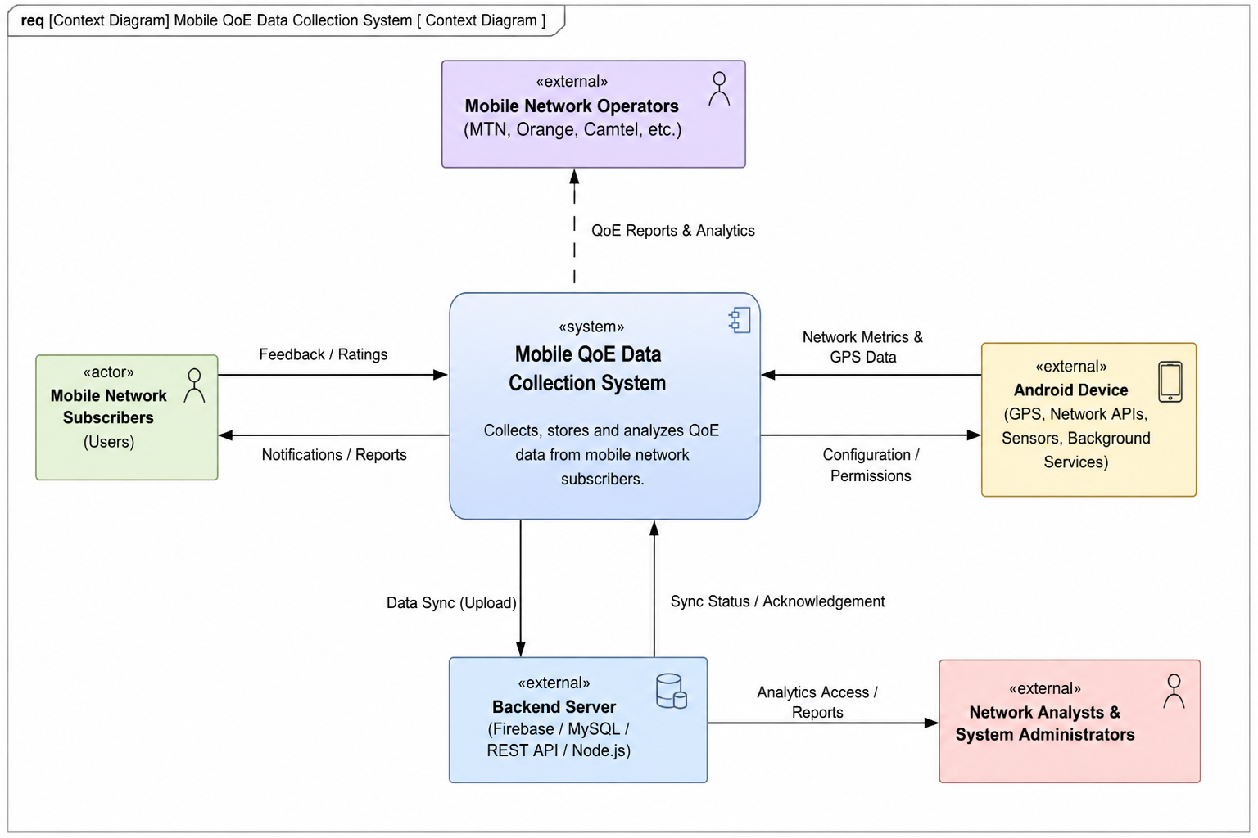
SYSTEM MODELLING
Context Diagram
Purpose: Defines the system boundary and how the QoE App interacts with outside actors.
Subscribers: Provide feedback/ratings; receive notifications & reports.
Android device: Supplies network metrics & GPS data.
Backend server: Handles sync, storage, and analytics access.
Operators & analysts: Receive QoE reports and analytics for optimization.
Context Diagram — Mobile QoE Data Collection System
15

Slide 17
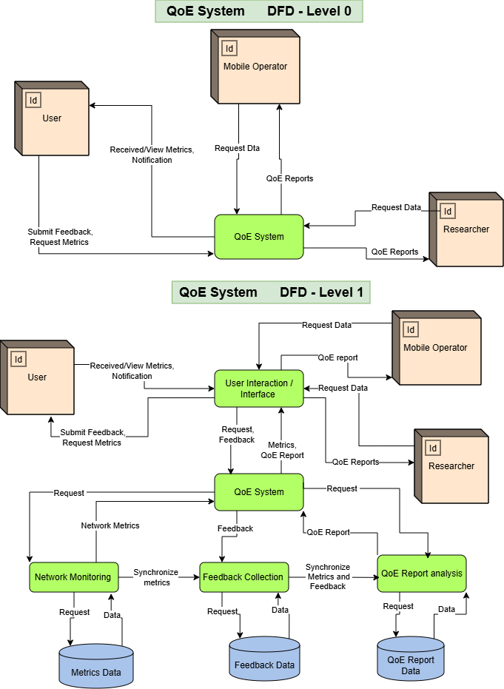
SYSTEM MODELLING
Data Flow Diagram (Level 0 & 1)
Notation: Gane & Sarson, modelled in Draw.io.
Level 0: Users, Mobile Operators & Researchers exchange feedback, metrics, and QoE reports with the central QoE System.
Level 1: Breaks the system into User Interaction, Network Monitoring, Feedback Collection, and QoE Report Analysis processes.
Data stores: Metrics Data, Feedback Data, and QoE Report Data.
]
DFD Level 0 & Level 1 diagrams
16

Slide 18
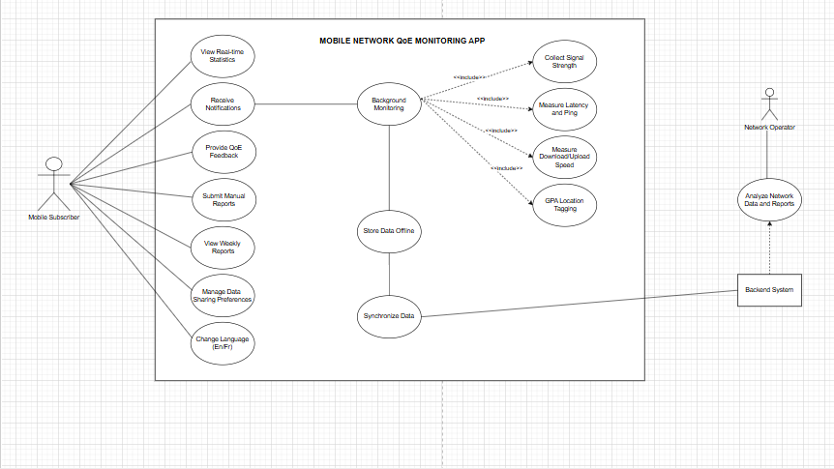
SYSTEM MODELLING
Use Case Diagram
Actors: Mobile Subscriber, Network Operator, Backend System.
Core use cases: Background monitoring, view real-time stats, collect signal/latency/speed, GPS tagging, offline storage & sync.
User-driven: Provide QoE feedback, submit manual reports, view weekly reports, manage data-sharing preferences, bilingual support.
Includes: Background Monitoring includes signal, latency, speed & GPS collection sub-cases.
Use Case Diagram — Mobile Network QoE Monitoring App
17

Slide 19
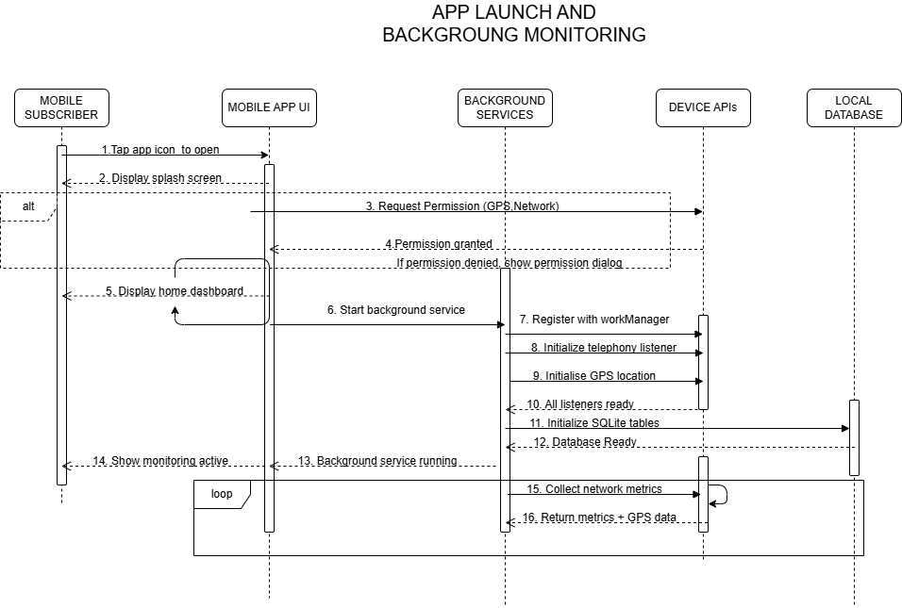
SYSTEM MODELLING
Sequence Diagrams
1
App Launch & Background Monitoring Start
2
Network Metrics Collection & Offline Storage
3
Offline-to-Online Data Synchronization
4
User Feedback Prompt & QoE Rating Collection
5
Manual Network Problem Report Submission
Every record is tagged with GPS, timestamp, operator & device model — data stored in SQLite is never lost, even offline, and syncs via AES-256-encrypted HTTPS once connectivity returns.
Sequence diagram(s) for selected scenario(s)
18

Slide 20
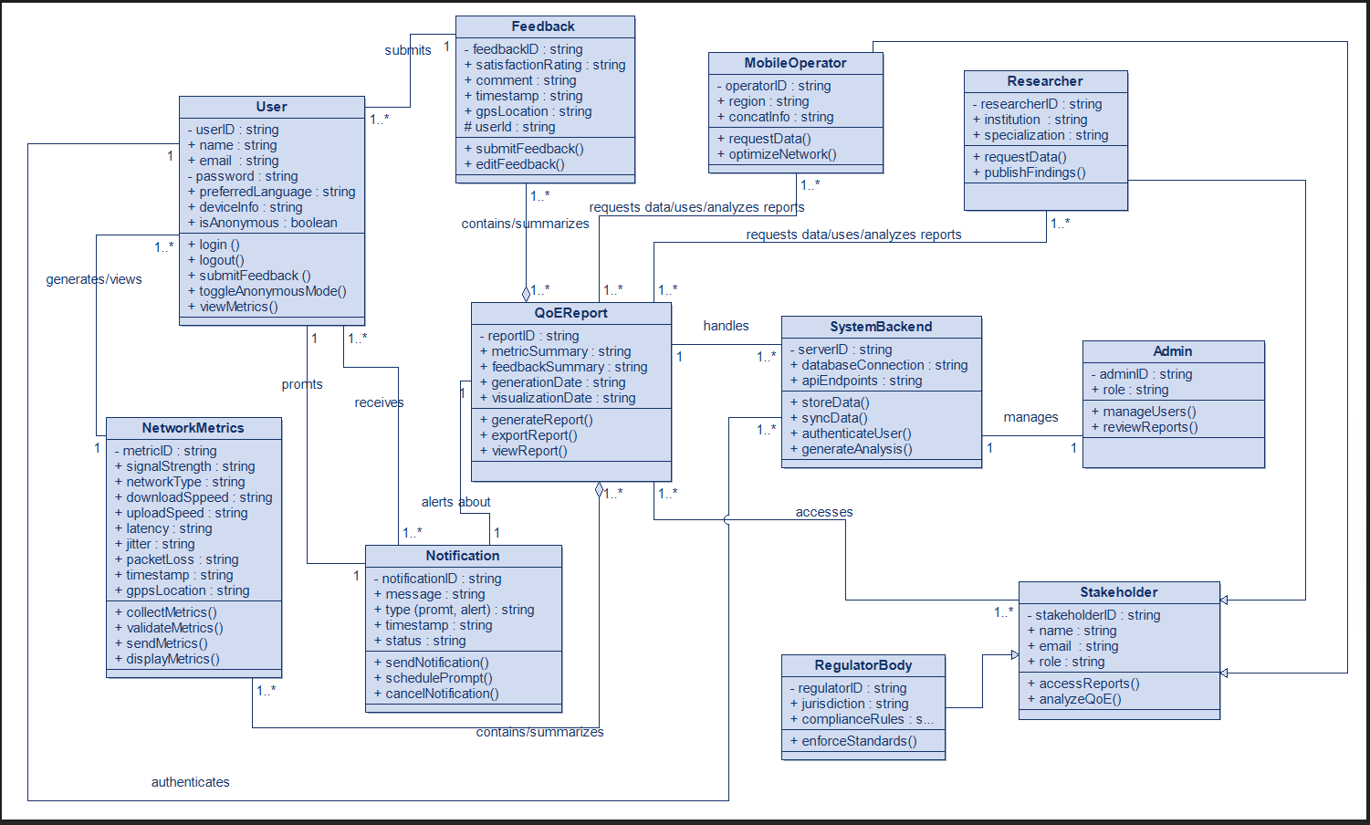
SYSTEM MODELLING
Class Diagram
Core classes: User, Feedback, NetworkMetrics, QoEReport, Notification, SystemBackend.
Stakeholder hierarchy: Admin, MobileOperator, Researcher & RegulatorBody inherit from an abstract Stakeholder class.
Key relationships: User submits Feedback & generates/views NetworkMetrics; QoEReport aggregates Feedback + Metrics.
Design features: Encapsulation via visibility markers, anonymous-user mode, scalable backend integration.
Class Diagram — QoE System
19

Slide 21
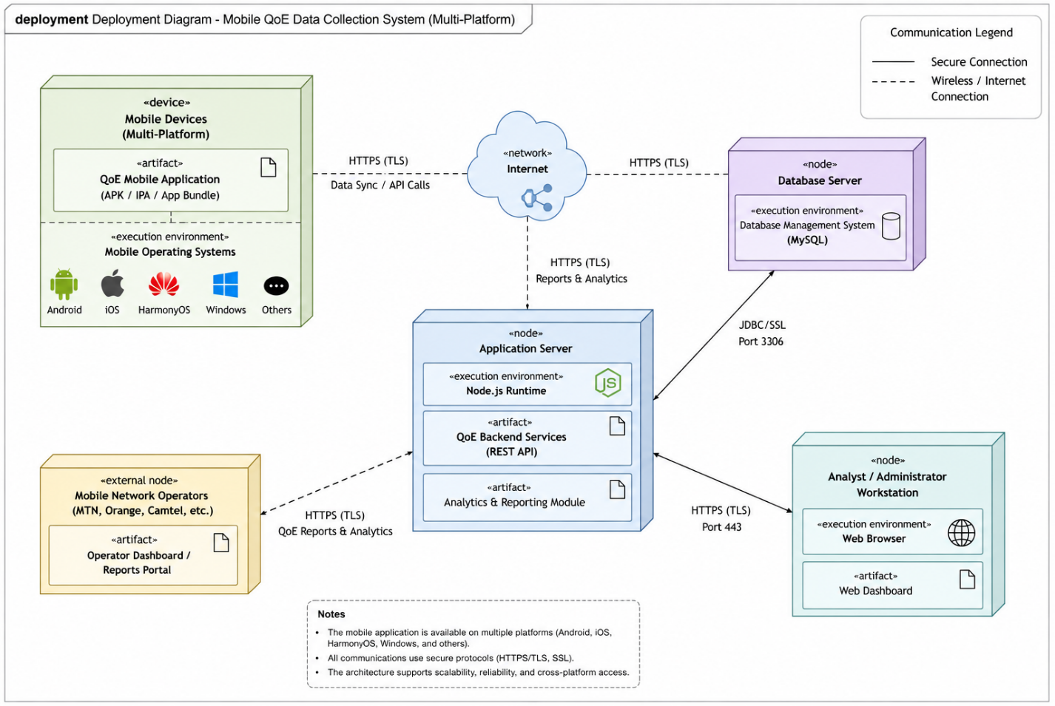
SYSTEM MODELLING
Deployment Diagram
Architecture: Distributed client-server model across mobile devices, app server, database, and dashboards.
Mobile devices: Android, iOS, HarmonyOS & Windows Mobile — cross-platform reach.
Application server: Node.js runtime hosting REST APIs & analytics module.
Database server: MySQL, connected via JDBC/SSL on port 3306.
Security: HTTPS/TLS everywhere, SSL-secured DB connections, authenticated access.
Deployment Diagram — Multi-Platform QoE System
20

Slide 22
UI/UX Design & Frontend
21

Slide 23

UI DESIGN
Brand Identity — NetPulse
Name: NetPulse
Tagline: "Measuring Network Experience, Empowering Connectivity."
Logo concept: Network signal icon + pulse waveform, in blue & green tones for technology, reliability, and growth.
Target users: Subscribers, MTN/Orange/Camtel/Nexttel, regulators, network engineers & researchers.
NetPulse logo & brand mark
22

Slide 24
UI DESIGN
Visual Design & Screens
COLOR PALETTE
KEY SCREENS
Blue #2563EB
Login: Authentication & role-based access
Subscriber Dashboard: QoE score, test submission, history
Operator/Admin Dashboard: Regional analytics, comparisons
Regulatory Dashboard: National overview & compliance
Green #10B981
Orange #F59E0B
Red #EF4444
23

Slide 25
FRONTEND IMPLEMENTATION
Tech Stack & Architecture
React Native
TypeScript
NativeWind
Cross-platform mobile framework
Static typing & maintainability
Tailwind CSS utility styling
Expo
React Navigation
React Hooks
Simplified build & deployment
Screen transitions & routing
useState / useEffect for state & data
Authentication: Registration, secure login, session persistence, role-based redirection
Visualization: Summary cards, interactive charts, regional comparison tables
Theming & language: Light/Dark mode; English & French support
24

Slide 26
Database & Backend
25

Slide 27
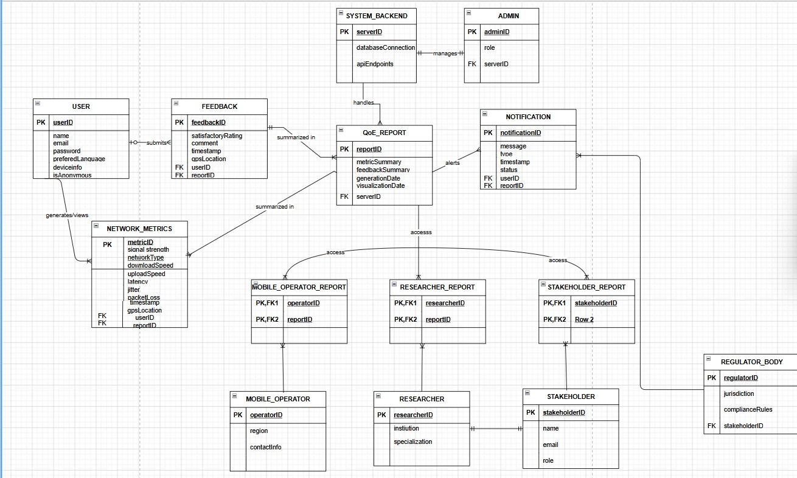
DATABASE DESIGN
Entity Relationship Diagram
9 entities: User, Session, Network Performance, User Feedback, Location, Notification, Alert, Analytics Report, QoE Prediction.
Relationships: All core relationships are one-to-many (1:M) — e.g. one User → many Sessions & Feedback entries.
Normalized: No duplicate data; referential integrity enforced via foreign keys.
AI-ready: Structure supports future machine-learning-based QoE prediction.
Entity Relationship Diagram — qoe_monitoring_db
26

Slide 28
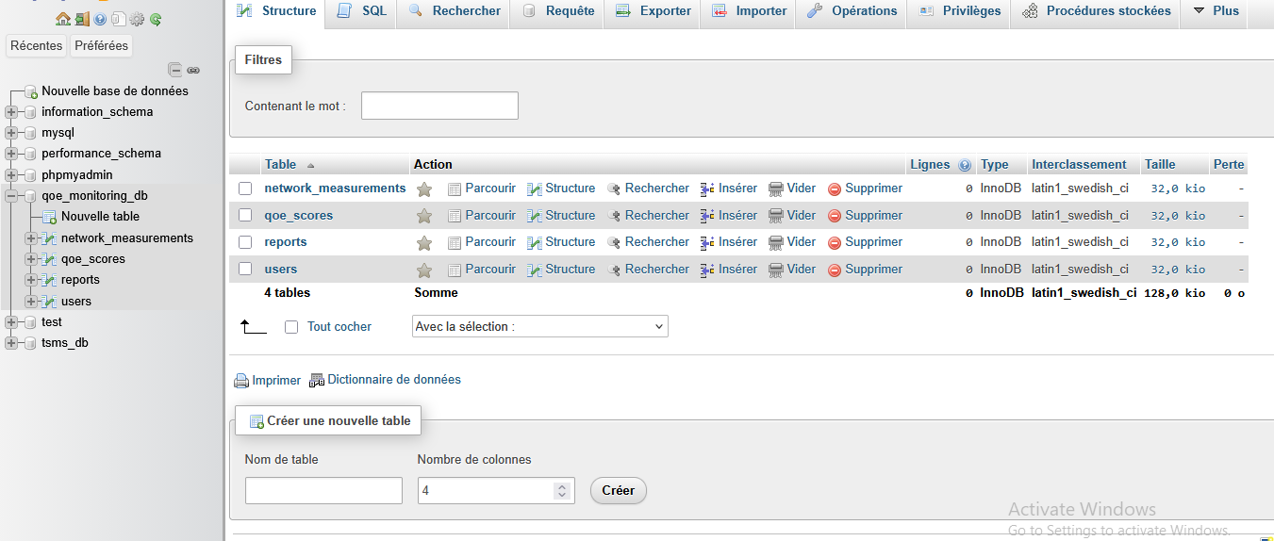
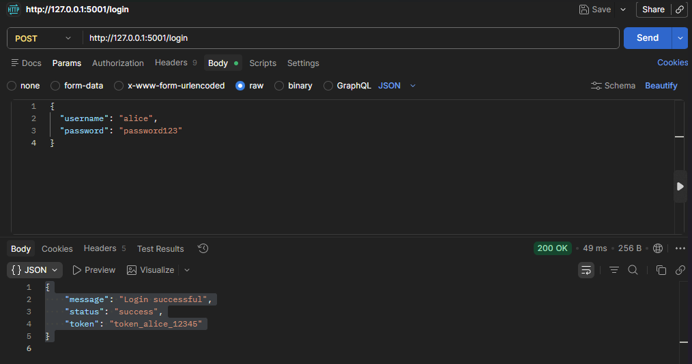
IMPLEMENTATION
Database & Backend
DATABASE — MySQL
BACKEND — Node.js / Express
qoe_monitoring_db with Users, Network Measurements, QoE Scores & Reports tables
Foreign keys link measurements & reports back to Users
Timestamps auto-generated on every record
Responsibilities: Authentication, data collection, QoE score computation, report generation, API management
Connection: MySQL2 driver via config folder connection file
Output: JSON API responses consumed by the React Native frontend
[ Insert Relevant Image / Diagram Here ]
Backend server logs / API test (Postman) screenshot
27

Slide 29
Testing, Deployment & Results
28

Slide 30
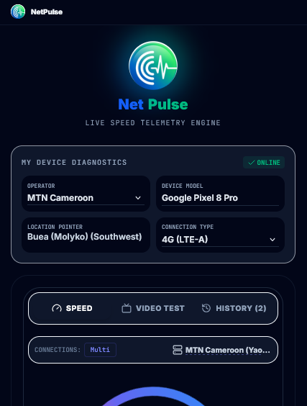
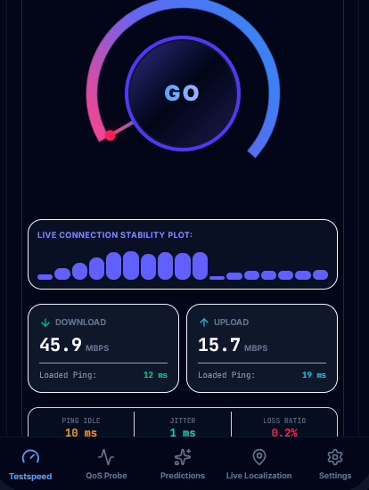
TESTING
Functional, Performance & Acceptance Testing
Test Case | Expected Result | Status
Run Network Test | Network metrics displayed correctly | Pass
Save Test Result | Test results stored in database | Pass
View History | Previous test records displayed | Pass
View Charts | Performance graphs generated correctly | Pass
Performance testing: Fast load times; smooth interactions; efficient DB read/write.
User acceptance testing: Classmates found the interface intuitive; minor tweaks applied before deployment.
App screenshots — live speed test & QoS history
29

Slide 31
RESULTS & DEPLOYMENT
From Testing to Launch
RESULTS
DEPLOYMENT
Real-time tests return download/upload speed, latency, jitter & network type
Historical results let users track performance changes over time
Graphical reports reveal periods of good vs. poor connectivity
Frontend, backend & database integrate stably end-to-end
Frontend compiled into a production-ready Android APK
Backend configured for secure database communication
Tested across multiple Android devices & screen sizes
Ready for future Google Play Store publication
30

Slide 32
Marketing Strategy & Business Model
31

Slide 33
GO-TO-MARKET
Target Market & Marketing Strategy
TARGET MARKET
MARKETING CHANNELS
Students, professionals & remote workers
Gamers needing low-latency insight
Researchers & regulators studying QoE trends
ISPs & telecom operators (MTN, Orange, Camtel)
Digital: Facebook, Instagram, LinkedIn, TikTok, YouTube
SEO: Content on speed optimization & QoE analysis
Partnerships: Universities & telecom operators
Growth: Referral program & email marketing
32

Slide 34
BUSINESS MODEL
Revenue Streams
Freemium
Advertising
Subscriptions
Free basic testing + Premium analytics & export
Non-intrusive ads (Google AdMob) on free tier
Monthly/yearly plans for premium features
Enterprise Licensing
API Services
Data Analytics
Custom dashboards for telecoms & institutions
Paid API access to anonymized QoE data
Privacy-compliant, consented aggregate insights
33

Slide 35
Challenges & Conclusion
34

Slide 36
CHALLENGES ENCOUNTERED
Problems & How We Solved Them
Challenge | Solution
Device compatibility differences | Additional testing & UI adjustments across devices
Fluctuating network conditions | Multiple sampling & averaging techniques
Third-party API limitations | Worked within rate limits; adapted feature scope
Foreign key / DB connection errors | Verified relationships; corrected credentials & ports
Time & resource constraints | Prioritized core features; iterative development
35

Slide 37
CONCLUSION
Key Takeaways & Goals Achieved
Full-stack delivery: NetPulse integrates a React Native frontend, Node.js backend, and MySQL database into one working system.
Both sides of QoE captured: Combines objective network metrics with subjective user feedback for a complete picture.
Validated by testing: Functional, performance, and user-acceptance testing confirmed reliable, intuitive operation.
Real-world relevance: Addresses a genuine gap for Cameroonian mobile subscribers and gives operators actionable insight.
Deployment-ready: Packaged as an Android APK, tested across devices, positioned for future Play Store release.
Room to grow: AI-based QoE prediction, outage detection, and crowd-sourced coverage maps mapped out as next steps.
36

Slide 38
Thank You
NetPulse • Group 19 • CEF 440 • University of Buea
37

